Slide 1
Image Restoration without Clean Data
Ji Tin Justin Li - A 20423037
Subowen Yan - A 20430537

Slide 2
Background and Problem statement
Sources of noise in signals and data
Signal reconstruction - subfield of statistical analysis
Application of CNNs on Image data
Machine learning problems: Lack of data
Notes:
Certain types of noises, does not affect the learned weights in a nn.
The paper, Noise2Noise, shows that both in a theoretical standpoint, and a practical standpoint, this statement is true.

Slide 3
Resource used
“Noise2Noise: Learning Image Restoration without Clean Data”
~ by Jaakko Lehtinen, Jacob Munkberg, Jon Hasselgren, Samuli Laine, Tero Karras, Miika Aittala and Timo Aila
-> From NVIDIA, Aalto University, and MIT CSAIL.
-> Paper released on 2018, at the 35th International Conference on Machine Learning
Notes:
Some background about the authors I guess.

Slide 4
Brief summary of the paper
Key idea: “it is possible to learn to restore images by only using images corrupted with noise”
Implications:
Noisy training targets perform just as well as clean targets
In many real life scenarios, lower quality data can be collected with lower capture budget i.e. higher volume of data (of lower quality) can be collected with the same capture cost.
-> Solves data constraints bottlenecks for real life machine learning problems!
Notes:
Intuitively, this is particularly helpful to data scientists since data constraints are the bottlenecks of many machine learning problems, and more available data usually leads to better generalization of models.
Below is a list of practical experiments that were run by the authors.
Training with synthetic data with zero-mean noise filters
Various noise generation processes were used to produce synthetic noisy targets, such as additive gaussian noise, poisson noise, multiplicative bernoulli noise, and text overlay filters. The results were promising as the trained models (with noisy targets) do show similar performance to models trained with clean targets. Comparison with other restoration benchmarks were also included, which showed the proposed network produced similar results to RED30 [2], another noise restoration conv. network with auto-encoders.
Training with Monte Carlo rendered images
Images from virtual scenes are rendered using Monte Carlo path tracing methods. This rendering method obtains the intensity of each pixel by calculating the expectation value from the sampled “light rays”, which inherently introduces noise to the rendered image. The noise introduced by the random path sampling process is zero-mean, such that the theory mentioned above applies. The practical results agree with the theory background. I.e. The model trained with noisy targets performs similarly to the model trained with clean targets.
Real life data application with undersampled MRI images
Modern MRI techniques rely on compress sensing to reduce the capture cost of each MRI scan. The signal is undersampled, and non-linear reconstruction is performed to produce a scan. A sampling parameter λ=10 is selected which controls the percentage of samples that are retained relative to a full sampling. The results show that the model trained with noisy targets shows similar testing loss to the model trained with clean targets as well.

Slide 5
List of practical experiments done in paper
Synthetic data with zero-mean noise filters
Monte Carlo rendered images
Real life data application with undersampled MRI images

Slide 6
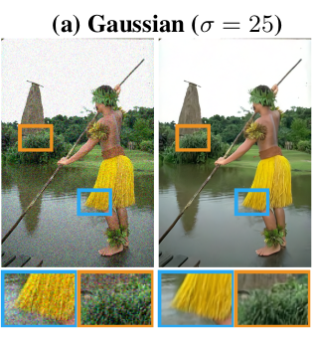
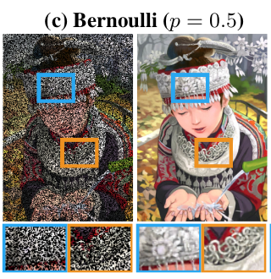
Test results obtained from Noise2Noise paper, using synthetic data with Gaussian and Bernoulli noise filter
Notes:
Input, prediction

Slide 7
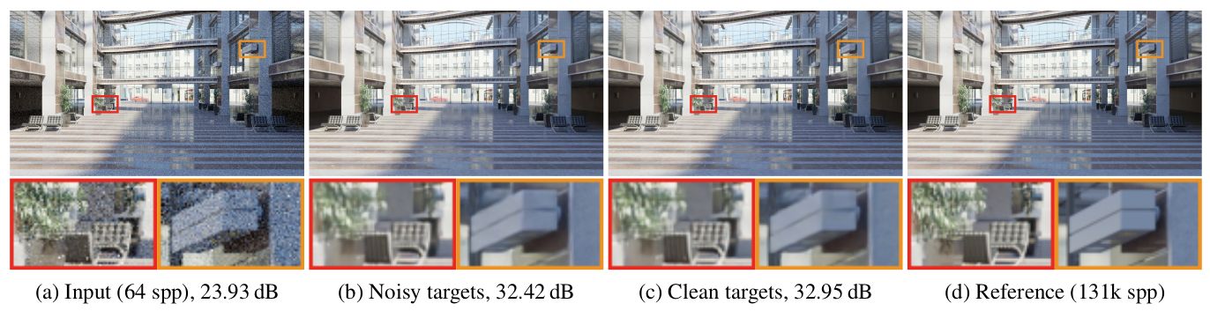
Test results obtained from Noise2Noise paper, using Monte Carlo rendered images
Notes:
Input, prediction

Slide 8
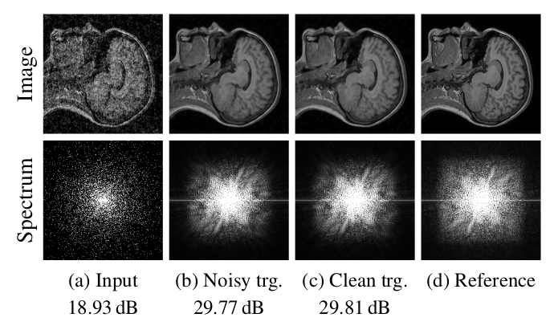
Test results obtained from Noise2Noise paper, using undersampled MRI scans
Notes:
Input, prediction

Slide 9
Proposed work
Implement CNN in keras to replicate their findings
Prepare noisy training and target images using specified noise filters
Filter types: Gaussian, Poisson, Multiplicative Bernoulli, Text overlay
Train models and evaluate the results

Slide 10
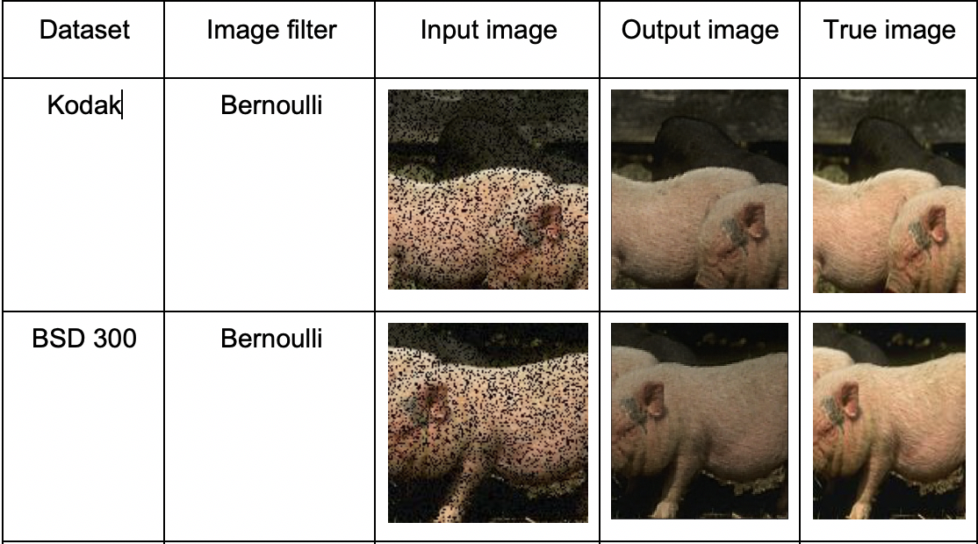
Results:

Slide 11
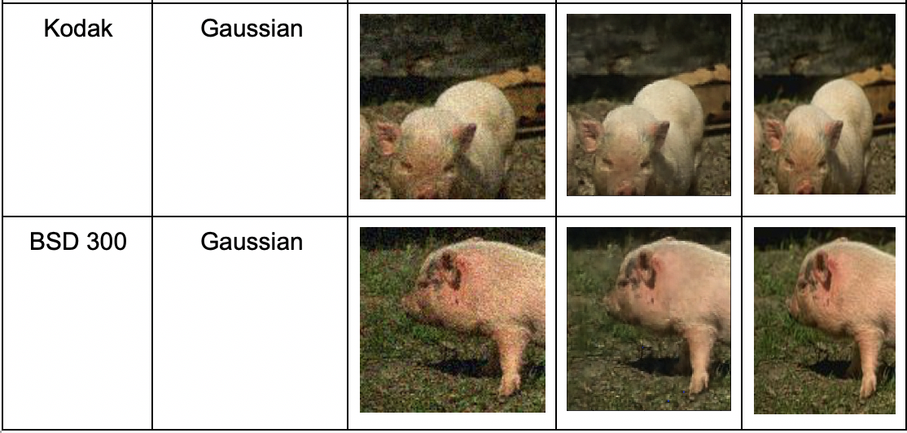
Results (continue):

Slide 12
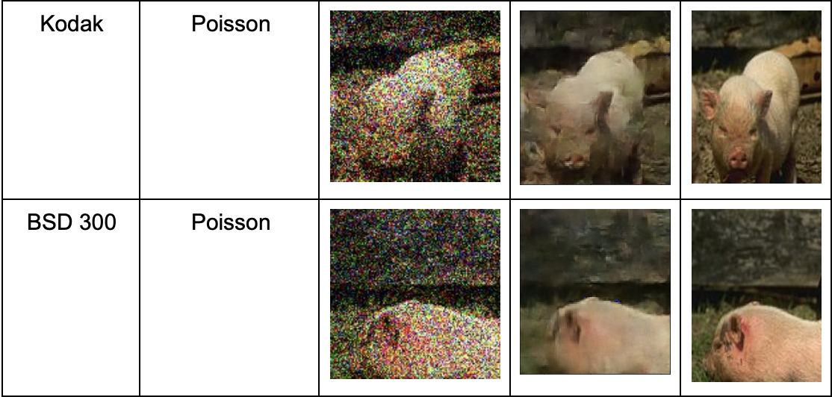
Results (continue):

Slide 13
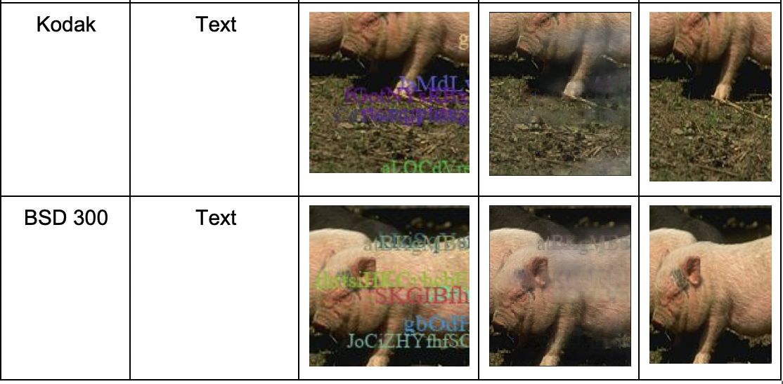
Results (continue):

Slide 14
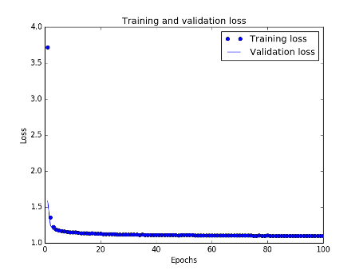
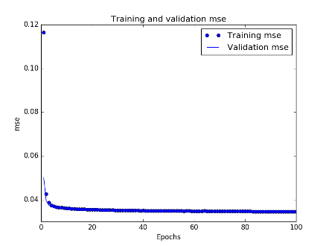
Loss and MSE

Slide 15
Conclusion:
we have presented the zero-mean distribution applied to deep neural networks to recover image signals. It is absolutely possible or even better to turn a corrupted image into a clean image without observing a clean image. We have shown that the statistical distribution noise, such as multiplicative Bernoulli, Gaussian, or Poisson can be removed with general-purpose deep convolutional models. This will significantly benefit many areas in the future.

Slide 16
Reference:
J. Lehtinen, J. Munkberg, J. Hasselgren, S. Laine, T. Kar- ras, M. Aittala, and T. Aila. Noise2Noise: Learning image restoration without clean data.
Mao, Xiao-Jiao, Shen, Chunhua, and Yang, Yu-Bin. Image restoration using convolutional auto-encoders with symmetric skip connections. In Proc. NIPS, 2016.
https://github.com/NVlabs/noise2noise/tree/master/dnnlib
http://r0k.us/graphics/kodak/kodak/
https://www2.eecs.berkeley.edu/Research/Projects/CS/vision/bsds/BSDS300-images.tgz

Slide 17
Thank you

